Slide 1
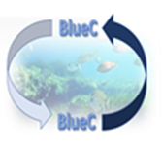


BSB00020 BlueC
Carbon Binding Blue Black Sea
Programme priority:
Blue and Smart Region
PP3 Ecological Counseling Center Cahul
08– 09 May 2025

Slide 2
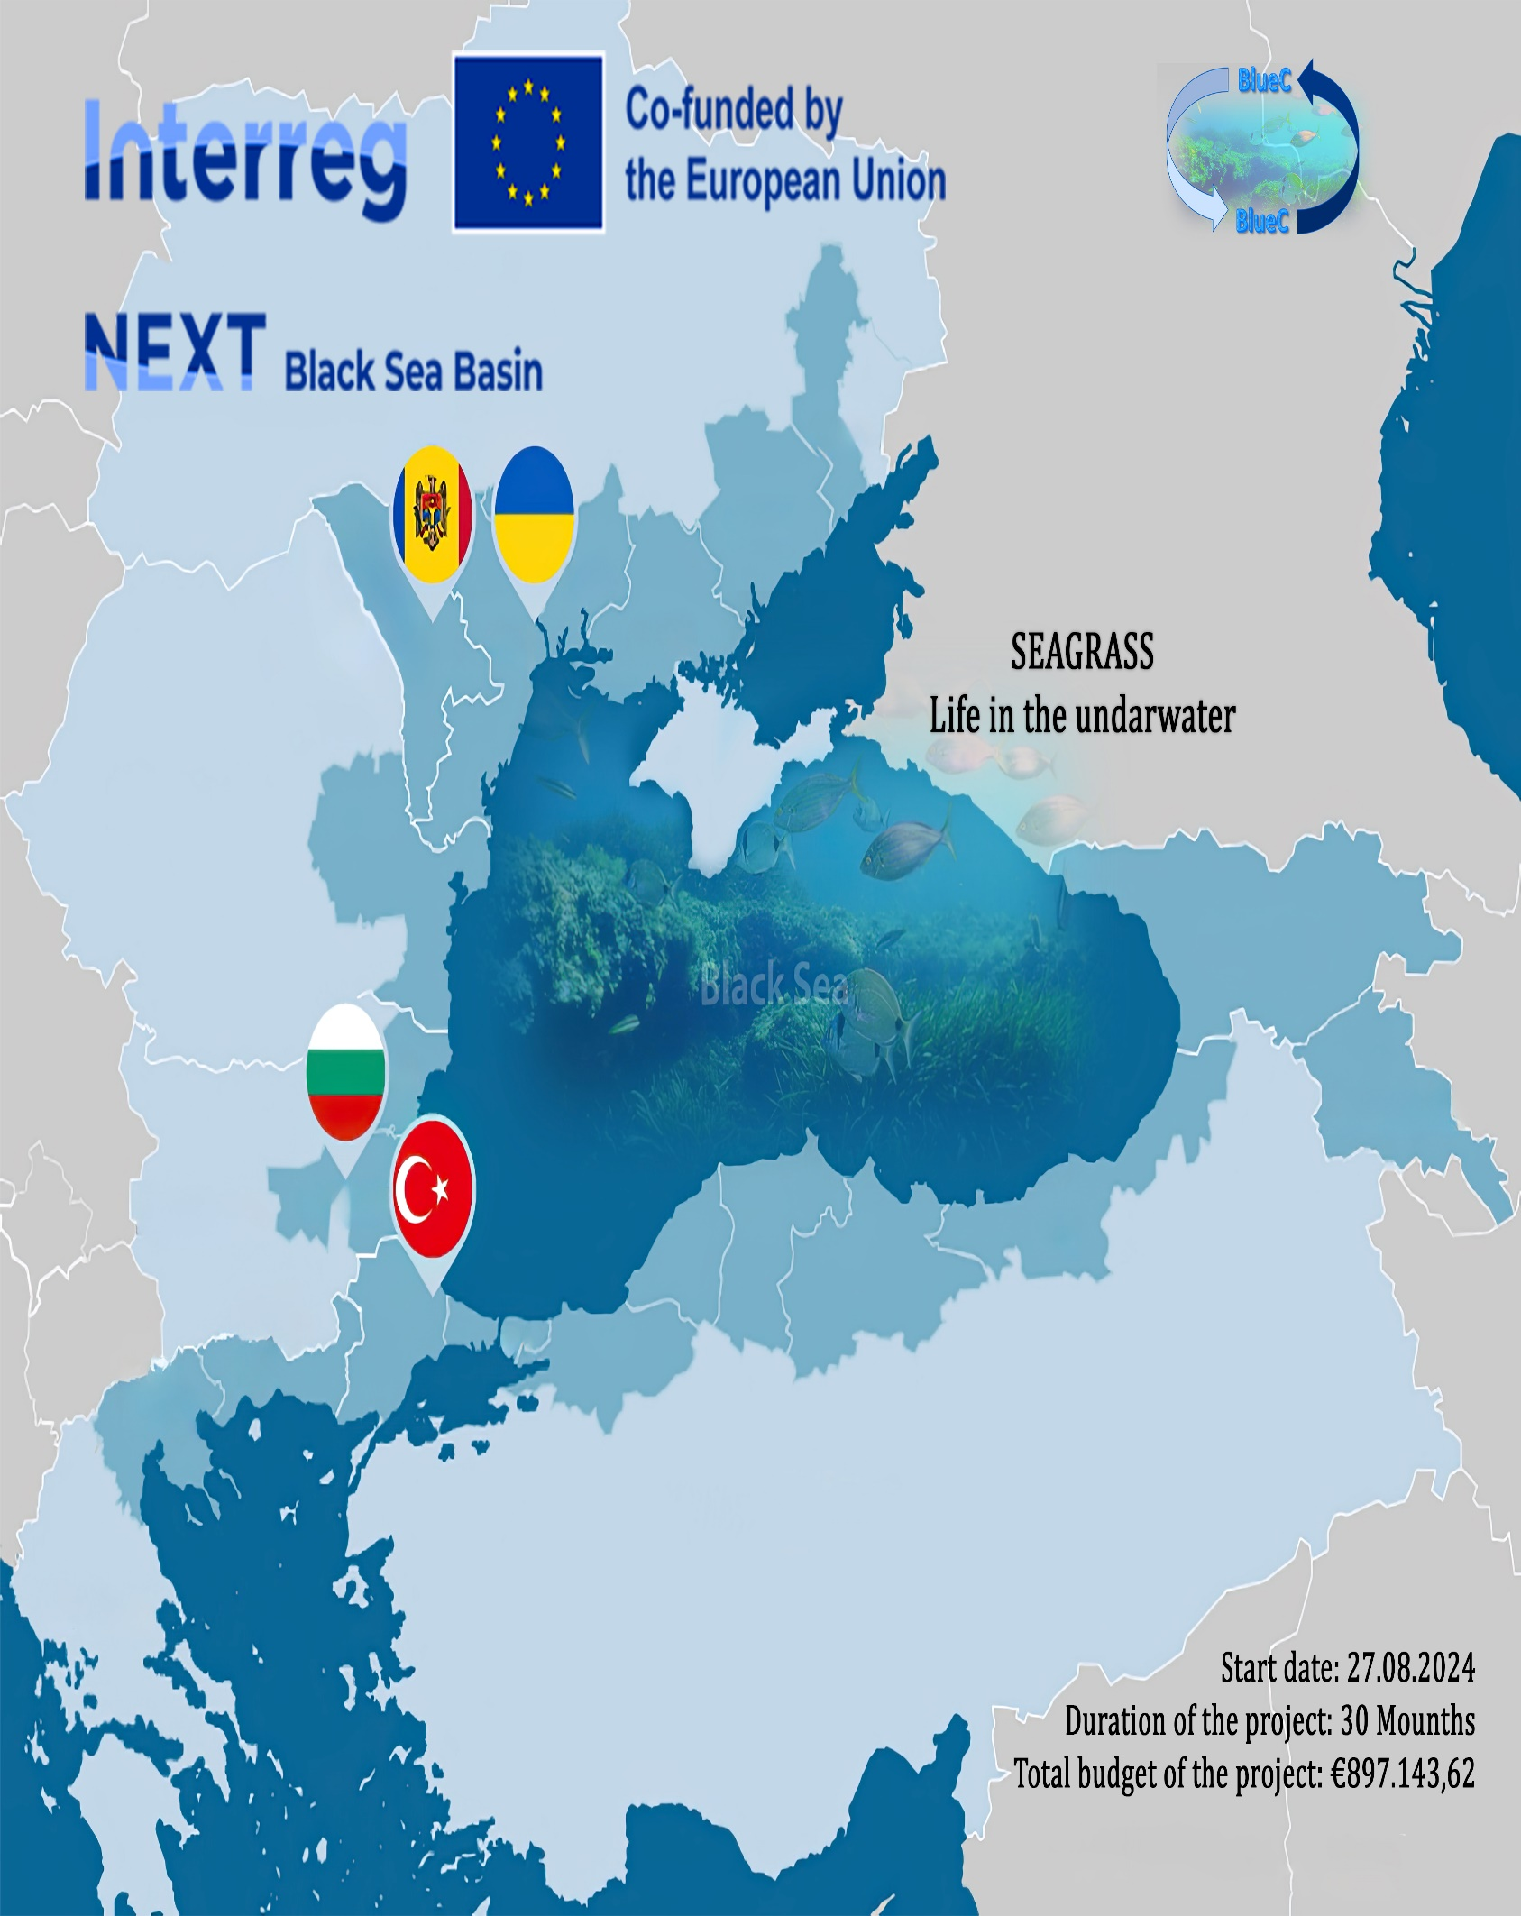
Theme of the presentation:
🌊 Water Resources and Environmental Assessment in the Prut River Basin
Hydrographic Overview, Ecological Studies & Litter Monitoring Initiatives

Slide 3
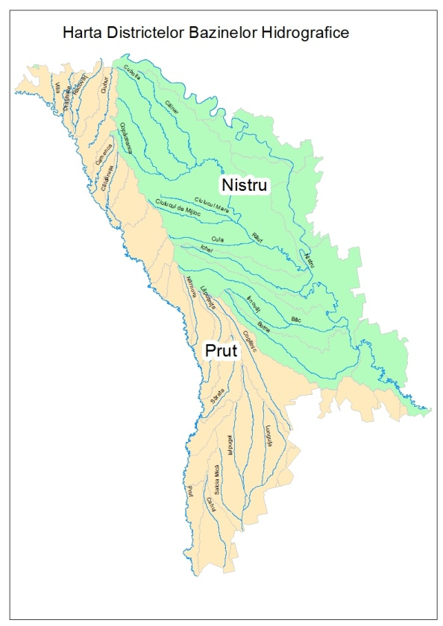
Hydrographic Network in the Republic of Moldova
The Republic of Moldova has a fairly developed hydrographic network; over 3,000 rivers and streams intersect its territory. All Moldovan rivers belong to the Black Sea basin and almost all of them follow the surface slope, flowing from northwest to southeast.
The most important water arteries of the Republic of Moldova are the large rivers Dniester (652 km), Prut (695 km) and Raut (286 km).
Map of river basin districts

Slide 4
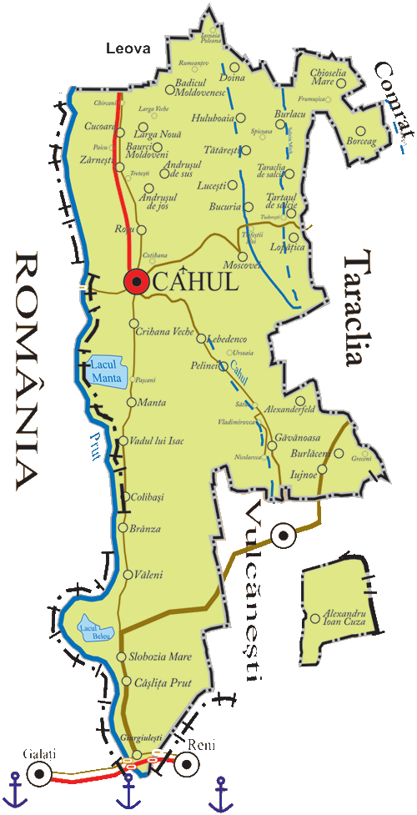
Cahul Region
Cahul district is located in the southern part of the Republic of Moldova, on the Lower Prut Plain. To the west, the district borders with Romania, to the south with Ukraine.
Cahul district includes 55 localities, of which 1 city and 37 communes (villages) with 53 rural localities in their composition. The total population - 120 thousand inhabitants.
The city of Cahul has the status of a spa resort.
In the district are the largest lakes in Moldova - Manta and Beleu. The 1200 -meter section of the Danube provides access to the Black Sea.
In 1991, in the lower course of the Prut, the “Prutul de Jos” Natural Reserve was founded, on an area of ​​1.7 thousand ha.

Slide 5
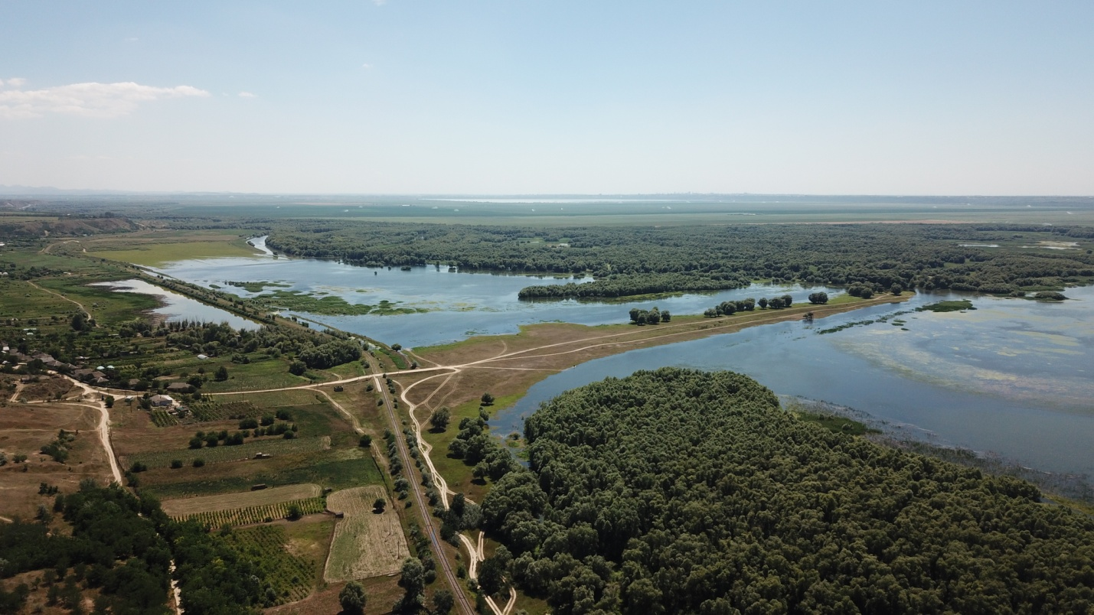
Cahul Region
In 2018, the International Coordinating Council of the UNESCO Man and the Biosphere Programme approved the registration of the Lower Prut Biosphere Reserve, which has now officially become the first biosphere reserve in Moldova.
Located in the south of the country, this biosphere reserve encompasses the Prut River and floodplain lakes. Two-thirds of the surface of the area is occupied by Lake Beleu. The wetland area extends along the Prut River, covering a mosaic of water, meadow and forest ecosystems.

Slide 6
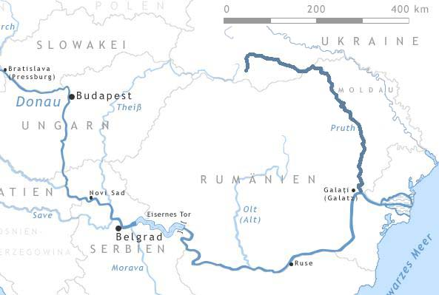
The Prut River Basin
The Prut River is one of the largest rivers in Western Ukraine, Moldova and Romania, one of the main tributaries of the Danube River. Of the total basin area, 28% of the Prut River basin is located in the territory of Moldova, 33%in the territory of Ukraine, and 39% in the territory of Romania. The Prut River originates on the south western slope of the Hoverla mountain (Ukraine), and discharges into the Danube River. Within the limits of the Republic of Moldova, the Prut River has a length of 695 km.
The river is used for drinking water supply of many localities, supply for communal industrial enterprises, for land irrigation, electricity production, for fish farming and navigation.

Slide 7
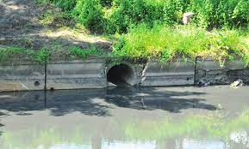
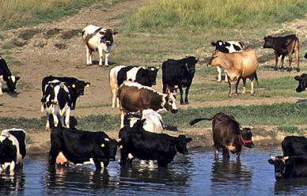
The main types of pressures within the Prut River basin
The main sources of pollution are:
Point source pollution (wastewater discharge);
Diffuse source pollution (agricultural activities, unauthorized dumps);
Hydro – morphological alterations (interruption of river continuity by the dam construction, density of irrigation and abstraction canals).

Slide 8
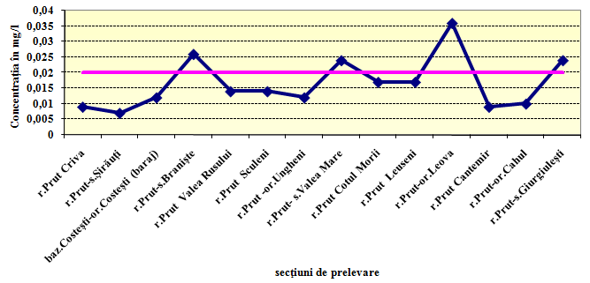
Water quality investigations in the Prut river basin
Following the detailed analyzes performed by the State Hydrometeorological Service, it is observed a higher concentration of pollutants downstream of large cities that do not have wastewater treatment plants and at the confluence with river tributaries.

Slide 9
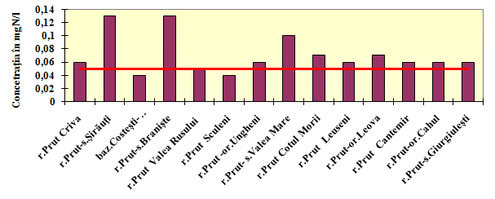
Water quality investigations in the Prut river basin
According to the results of the analyzes performed and represented graphically figure no. 2 it is observed that in all the samples taken, except the one from Sculeni village and the one taken from the Costești basin, were registered exceedances of the Maximum Permissible Concentrations (MPC) for petroleum products.
For anion-active detergents, copper compounds, ammonium ions, nitrates, no exceedance of the MPC was recorded.
Sampling sections
Fig.2. The variation of the concentration of petroleum products in the Prut River, from Criva to Giurgiulești

Slide 10
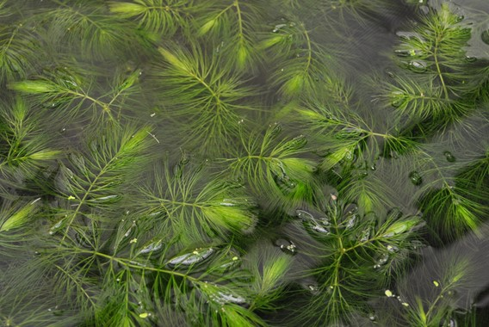
Ceratophyllum demersum L.
Ceratophyllum demersum L. – Key species for the analysis of freshwater ecosystems
Ceratophyllum demersum is a submerged aquatic plant, widely distributed in stagnant or slow-flowing freshwaters, and is one of the most common species found in the south of the Republic of Moldova, including the Lower Prut Biosphere Reserve. This species is recognized for its ability to form dense vegetation masses, to quickly colonize new habitats and to significantly influence the chemistry and biological structure of the aquatic environment.
Relevant data:
Documented presence in over 80% of lentic water bodies in the south of the country
Average biomass: 2.5–6.0 kg/m² (wet), depending on the season and water trophicity
High tolerance to moderate pollution conditions, variable pH and increased turbidity

Slide 11
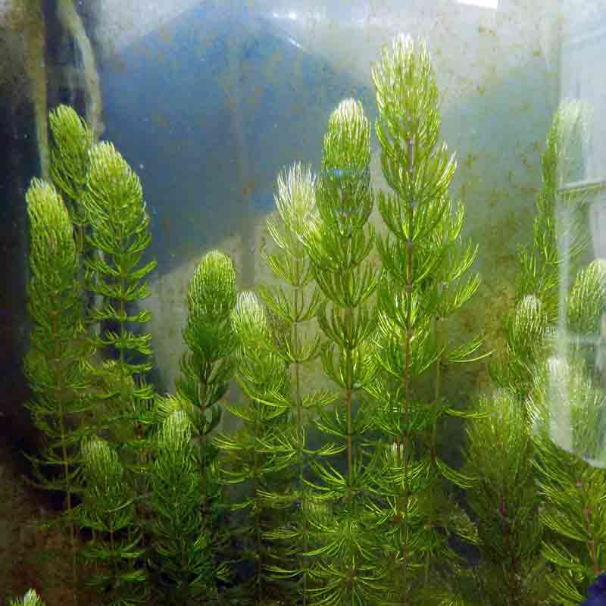
    Morphology, Biology, and Adaptation Mechanisms
Hornwort is a plant without anchored roots, which floats freely or is semi-fixed in the water column. It has long, thread-like leaves arranged in whorls (8–10 per node), allowing for a large surface area for gas exchange and nutrient absorption.
Relevant ecological mechanisms:
Intense vegetative reproduction: broken stems easily regenerate
Rapid growth: up to 1.8 cm/day, with peak growth during May–July
Ecological plasticity: tolerates temperature fluctuations between 10–30°C and low oxygen concentrations
Important role in habitat structure – reduces excessive solar radiation and stabilizes water temperature

Slide 12
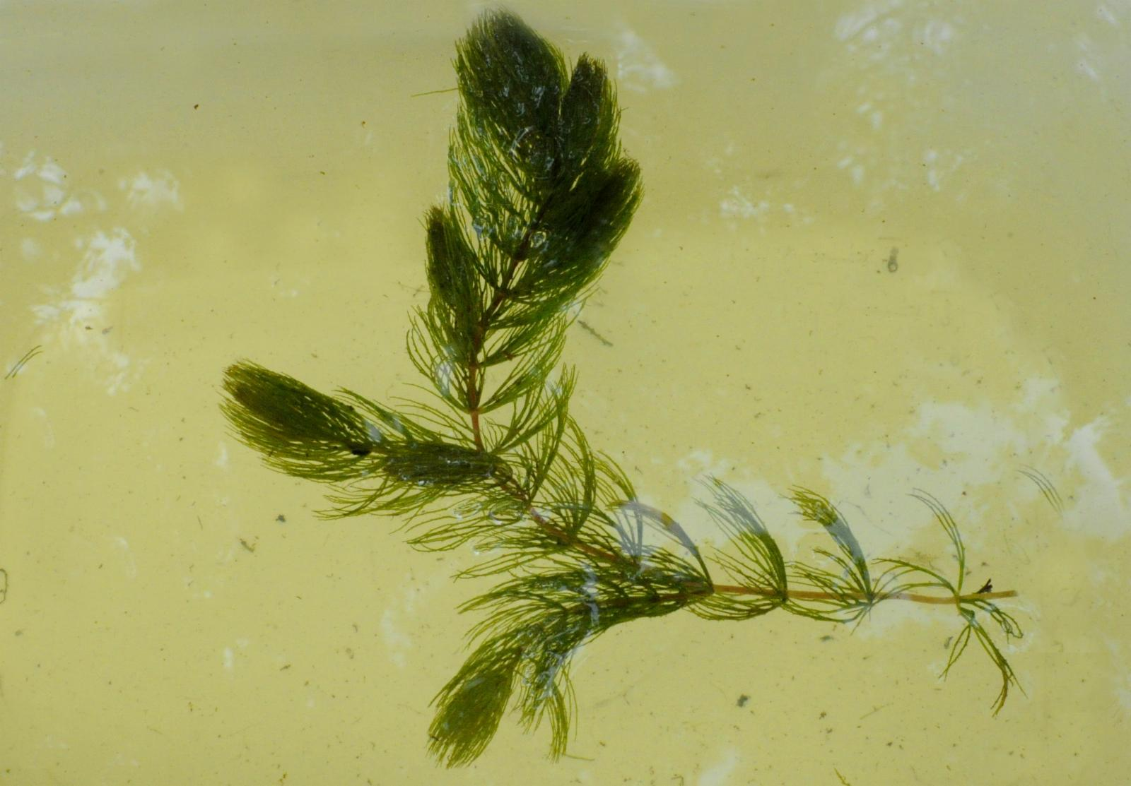
Ecosystem Services Provided by Ceratophyllum demersum
🔹 Eutrophication control
It absorbs significant amounts of nitrogen and phosphorus:
Total nitrogen: 1.1 g/day
Phosphorus: 0.12 g/day
In densely colonized areas, nutrient concentrations can decrease by up to 40%, reducing the risk of algal blooms.
🔹 Contribution to carbon sequestration
Due to its high biomass, it stores approximately 290–360 g C/year.
Plant degradation contributes to organic matter deposits at the bottom of water bodies.
🔹 Biodiversity support
It provides shelter for over 60 species of macroinvertebrates and serves as a breeding ground for fish and a refuge for larvae.

Slide 13
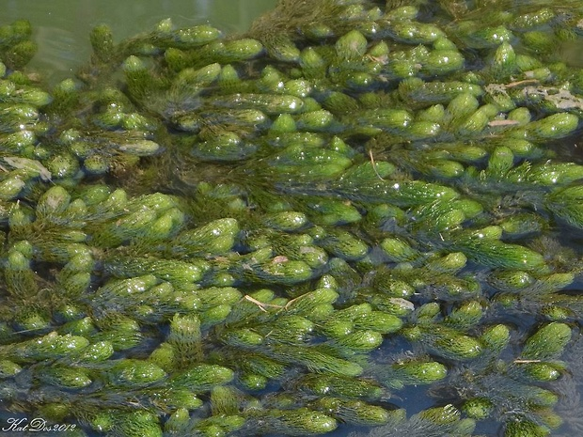
    Scientific Relevance for the BlueC Project
In the absence of seagrasses (e.g., Zostera marina) in the Lower Prut region, Ceratophyllum demersum serves as a functional-ecological alternative:
It has a comparable carbon sequestration profile, achieving 70–80% of the performance of marine seagrasse
It is easily monitored using standardized methods (e.g., underwater transects, wet biomass sampling)
It is integrated into water quality bioassessment schemes, serving as an indicator under the European Water Framework Directive (WFD)
It enables the application of a methodology adapted to freshwater ecosystems, while remaining aligned with the requirements of the INTERREG NEXT Black Sea Basin program

Slide 14
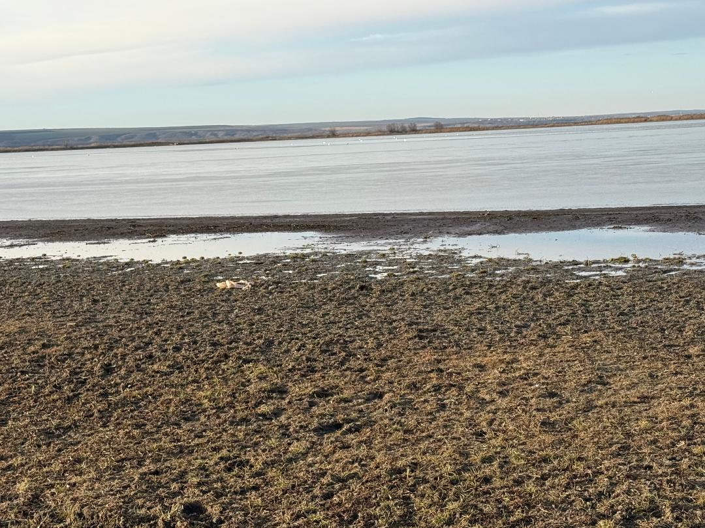
OSPAR Marine Litter Monitoring Survey

Slide 15
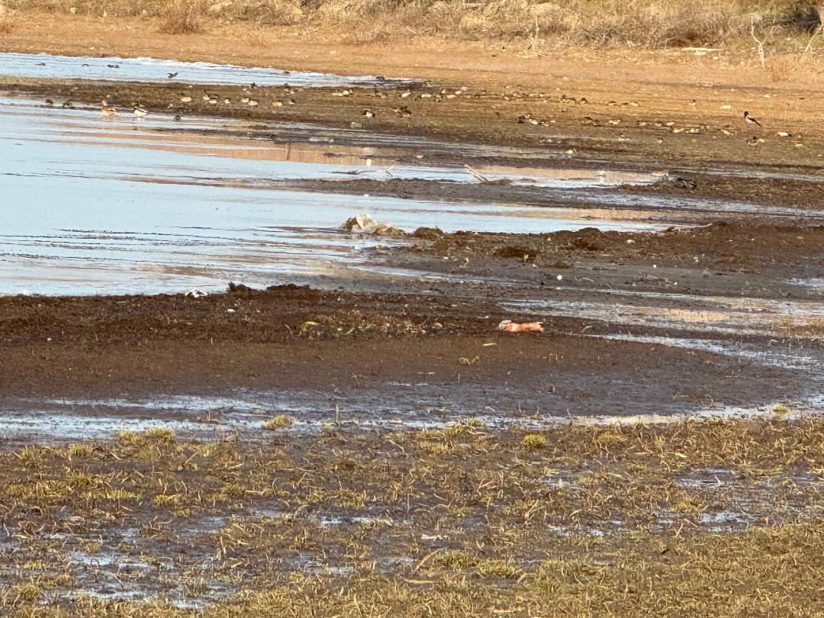
Manta Lake, Republic of Moldova
      This report presents the results of a standardized litter survey conducted under the OSPAR methodology on a 100-meter section of Manta Lake. The goal was to document the presence and types of litter to support ongoing environmental monitoring in inland water bodies.
      📌 General Observations:
      No litter was collected during this survey
      The survey strictly followed the 100-meter section
      No dead or entangled animals were found
      Minor access issues due to terrain conditions, but no significant impact on data quality

Slide 16
♻️ Key Findings - Types of Waste Identified
🔹 Most Common Types of Waste (Selected Examples):
Category | Examples of Waste | Quantity
Plastic | Wrappers, pens, bottle caps, gloves, containers | 90+ items
Fishing Gear | Nets (< and > 50 cm), ropes, fish boxes | 80+ items
Wood & Textiles | Ice cream sticks, crates, clothing, sacks | 60+ items
Metal & Glass | Drink cans, bottle caps, foil wrappers, bottles | 40+ items
Sanitary Waste | Cotton buds, tampons, pads | 38+ items
Paraffin Pieces | Up to 20 pieces per meter (strandline) | Frequent
🧪 Microplastics (pellets/nurdles) - ✔️ Detected
🌿 Environmental Note - While overall litter quantities were moderate, the diversity and persistence of plastic-based items suggest long-term ecological concerns.

Slide 17
✅ Final Conclusion
The Prut River basin, with its complex hydrographic network and rich biodiversity, faces multiple environmental pressures ranging from anthropogenic pollution to ecosystem degradation. Scientific studies — including water quality assessments and species monitoring like Ceratophyllum demersum — play a crucial role in understanding these dynamics and identifying ecological indicators.
The integration of standardized tools such as the OSPAR Marine Litter Monitoring Survey highlights the growing need for cross-border collaboration in tackling freshwater and marine pollution.
🔹 Sustainable water management
🔹 Targeted conservation actions
🔹 Ongoing scientific research
…are all essential pillars in preserving the ecological integrity of the Prut River basin and supporting projects like Carbon Binding Blue Black Sea - BlueC in achieving real, data-driven impact.

Slide 18

Thank you for your attention!

